Slide 1
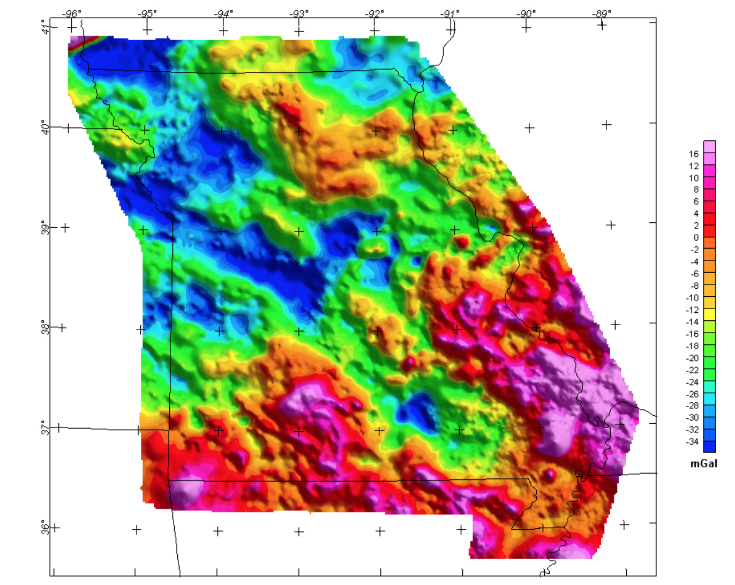
Gravity
Or, why an apple falls from a tree…

Slide 2
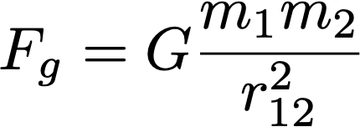
Gravity - The Force
One component of gravity is a force between two objects with mass:

Slide 3
Gravity - The Force
One component of gravity is a force between two objects with mass:
Note: what is the dimensionality of this quantity?
What else does Fg equal?

Slide 4
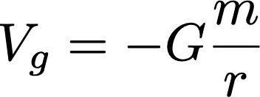
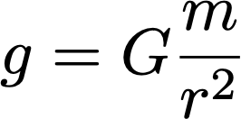
Gravity - The Force, The Potential, The Field
One component of gravity is a force between two objects with mass:
Gravity is also a potential:
And a field:

Slide 5
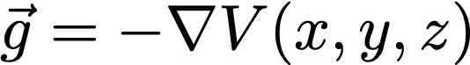
Gravity - The Force, The Potential, The Field
One component of gravity is a force between two objects with mass:
Gravity is also a potential:
And a field:
The field is the negative gradient of the potential:

Slide 6
Gravity - The Force, The Potential, The Field
One component of gravity is a force between two objects with mass:
Gravity is also a potential:
And a field:
The field is the negative gradient of the potential:
This is the magnitude of the gravity acceleration

Slide 7
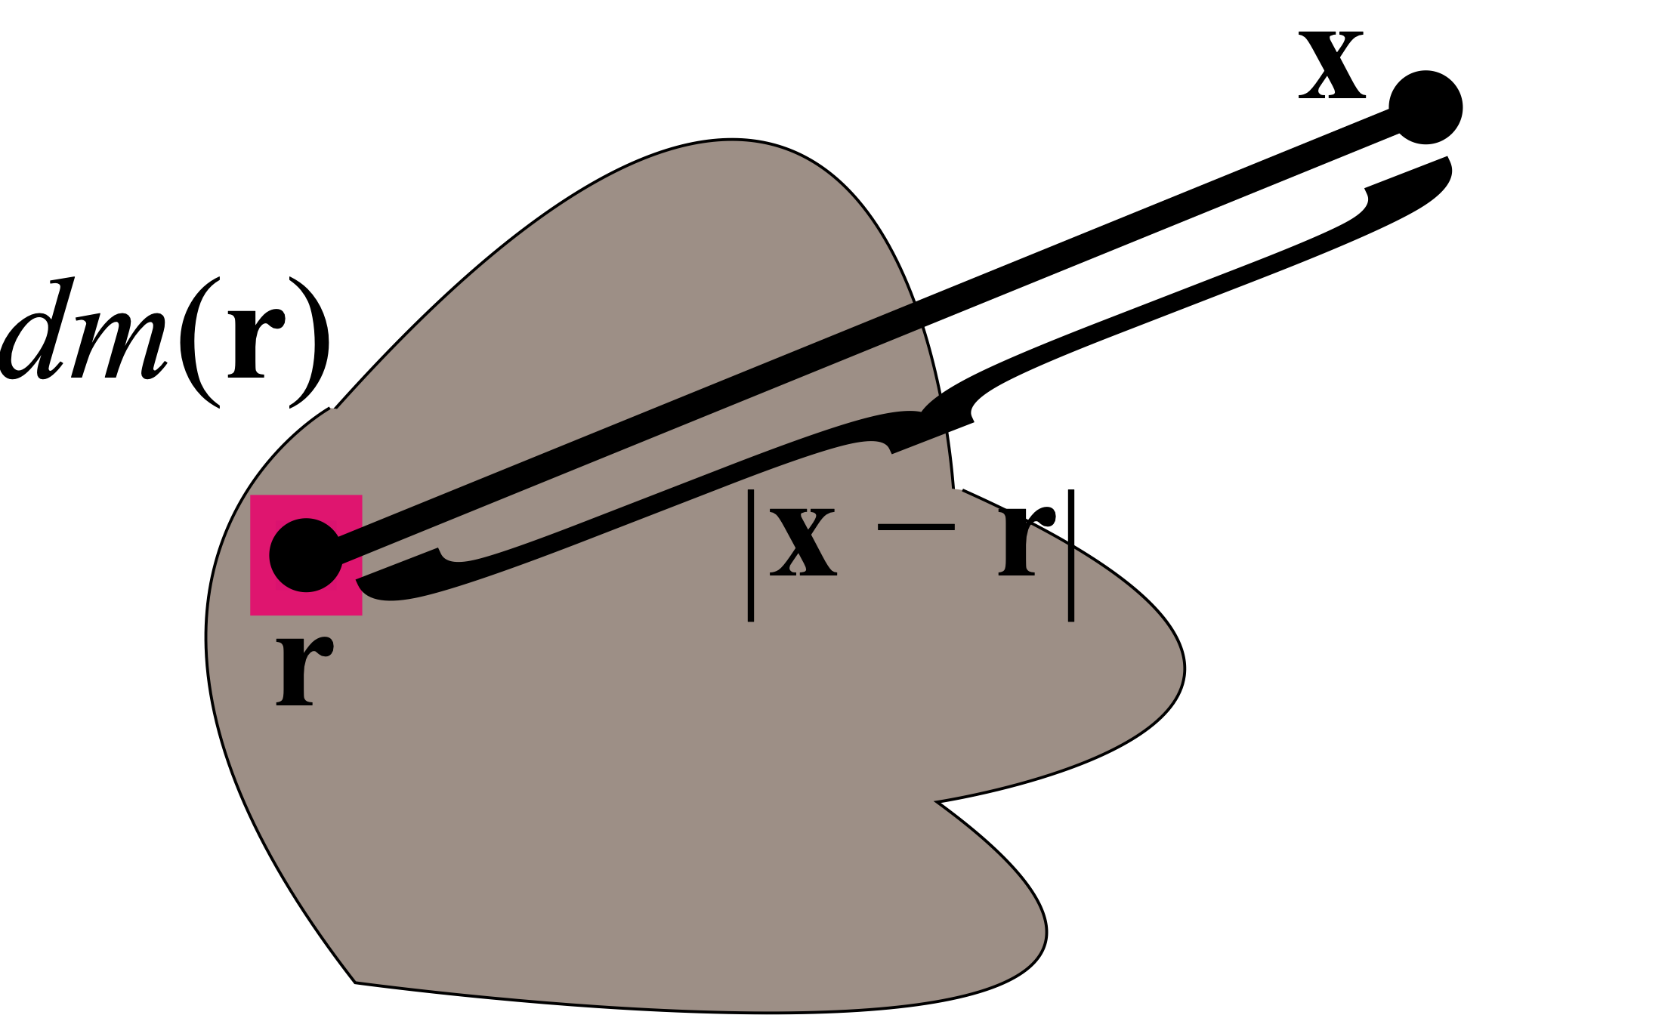
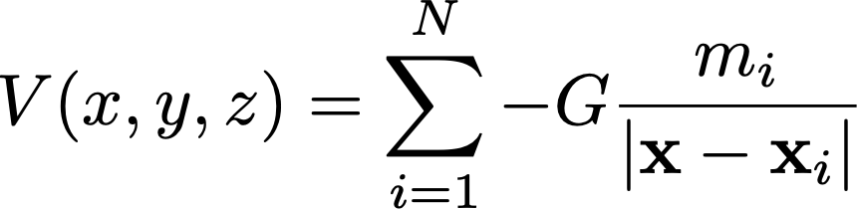
Gravity - The Field
We measure the the vertical component of the local acceleration of gravity, g
We relate these variations to spatial variations in m
We can integrate or sum to obtain the full potential:
Sławomir Biały, Incnis Mrsi, Wikipedia Commons

Slide 8
Gravity - The Field
We measure the the vertical component of the local acceleration of gravity, g
We relate these variations to spatial variations in m
We can integrate or sum to obtain the full potential:
Sławomir Biały, Incnis Mrsi, Wikipedia Commons
Note: acceleration is always a vector, but we usually take only the vertical component of the vector, which is perpendicular to the potential and parallel to a plumb line

Slide 9
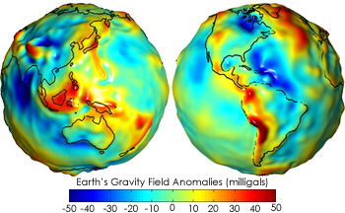
The Geoid
The geoid is an equipotential surface; i.e. V = constant
The geoid is one particular equipotential surface, there are infinitely many others

Slide 10
The Geoid
What are the variables? I.e. what causes these variations?

Slide 11
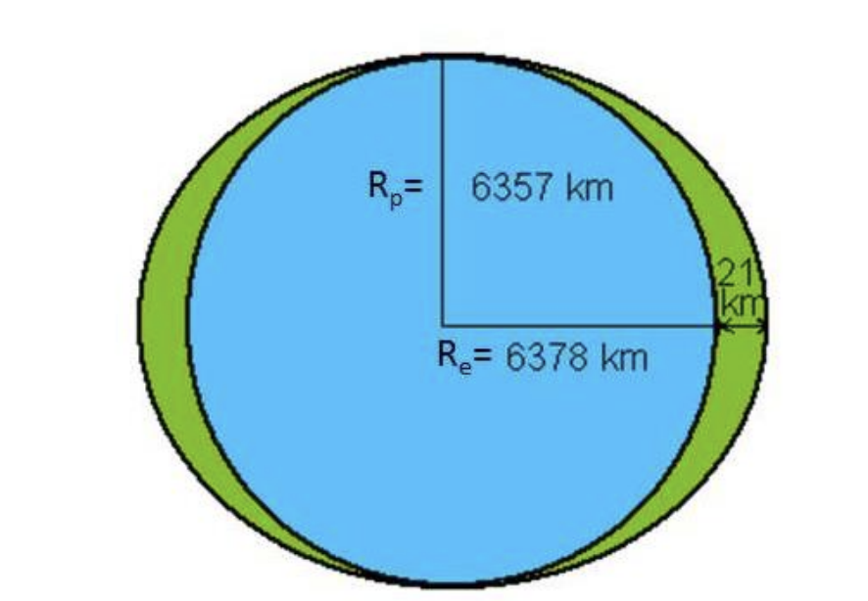
The Geoid
What are the variables?
Earth’s flattening due to rotation
Gravity is stronger at the poles due to being closer to the center of mass of the earth
Q. What about the extra mass at the equator?
http://appliedgeophysics.berkeley.edu/gravity/

Slide 12
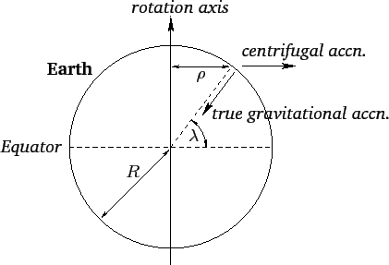
The Geoid
What are the variables?
Earth’s flattening due to rotation
Centrifugal acceleration due to rotation (acts opposite g)
The centrifugal acceleration cancels out a portion of g
Q. What is the functional form of a_{c}?
https://farside.ph.utexas.edu/teaching/336k/Newtonhtml/node57.html

Slide 13
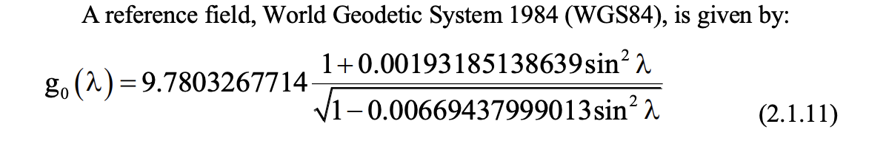
The Geoid
What are the variables?
Earth’s flattening due to rotation
Centrifugal acceleration due to rotation (acts opposite g)
These result in a latitude dependence, i.e. ellipsoidal geoid
http://appliedgeophysics.berkeley.edu/gravity/

Slide 14
The Geoid
The geoid is an equipotential surface; i.e. V = constant
The local vertical direction (i.e. local gravity acceleration direction) varies as the potential varies

Slide 15
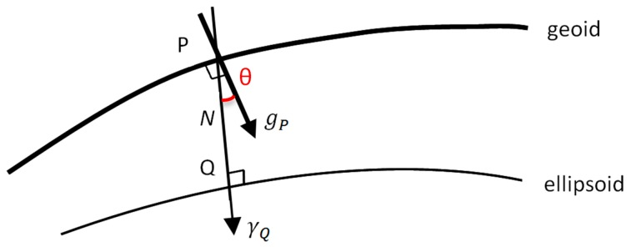
The Geoid
The geoid is an equipotential surface; i.e. V = constant
The local vertical direction (i.e. local gravity acceleration direction) varies as the potential varies away from the ellipsoid
This is known as “deflection of the vertical”

Slide 16
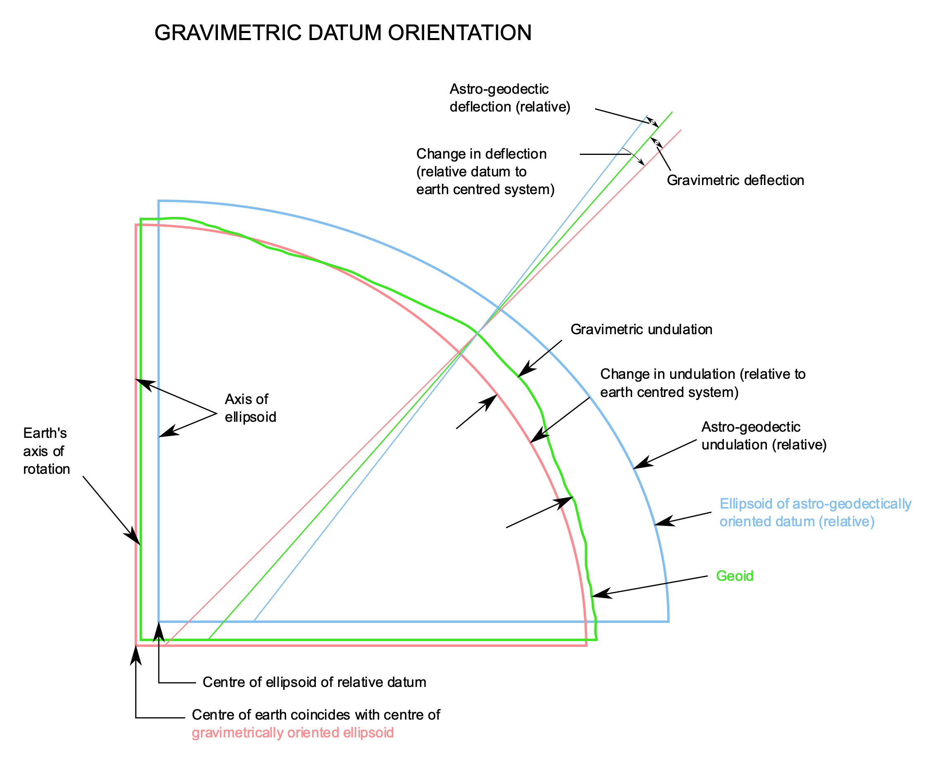
The Geoid
The geoid is an equipotential surface; i.e. V = constant

Slide 17
The Geoid
The geoid is an equipotential surface; i.e. V = constant
Q. What is causing these variations?

Slide 18
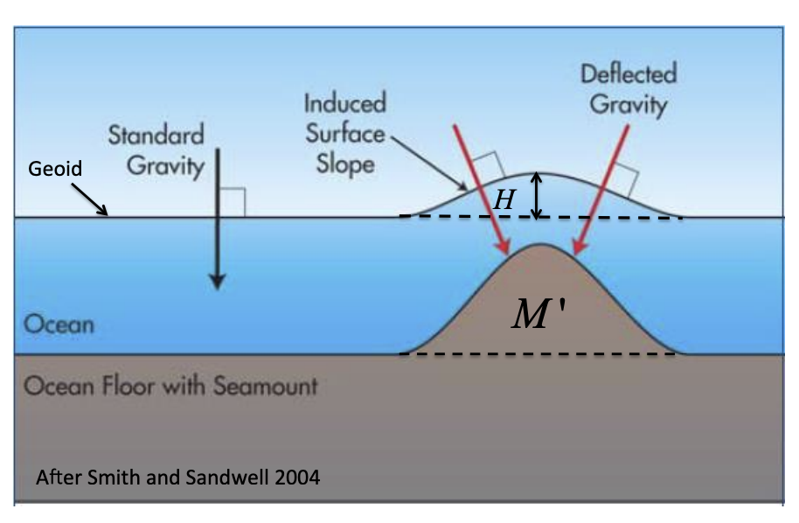
The Geoid
The geoid is an equipotential surface; i.e. V = constant
The local vertical direction (i.e. local gravity acceleration direction) varies as the potential varies away from the ellipsoid
This is known as “deflection of the vertical”
http://appliedgeophysics.berkeley.edu/gravity/
Example: Undersea volcano

Slide 19
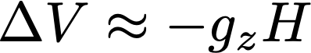
How to measure the geoid?
Satellite tracking + ground measurements + integration
Iterative process to refine the geoid then re-estimate

Slide 20
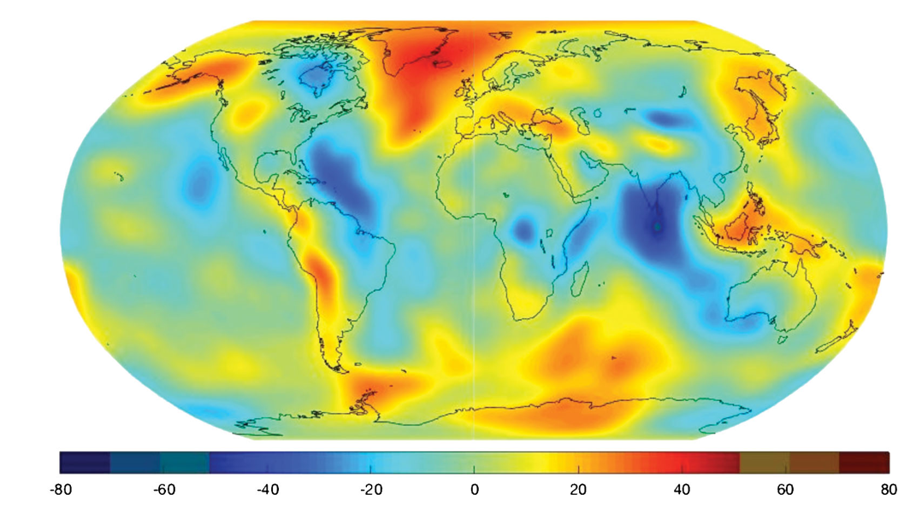
How to measure the geoid?
Satellite tracking + ground measurements + integration
Iterative process to refine the geoid then re-estimate
This is the anomaly from the ellipsoid!

Slide 21
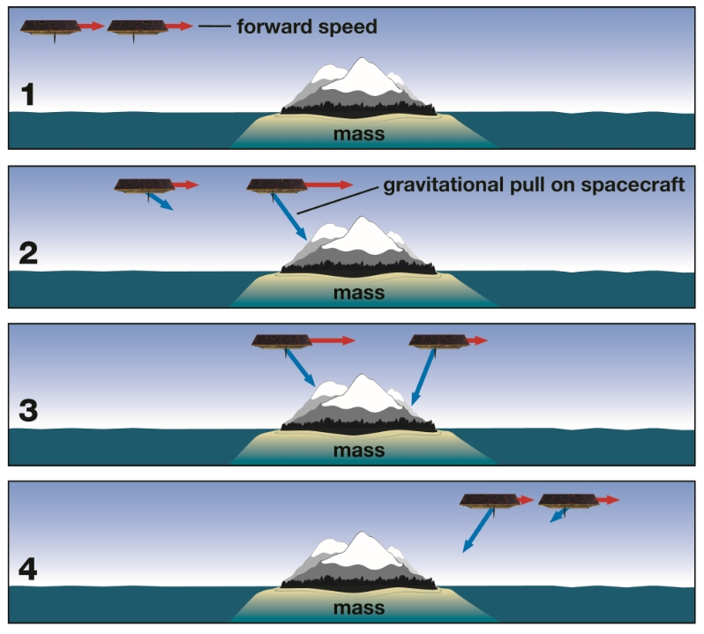
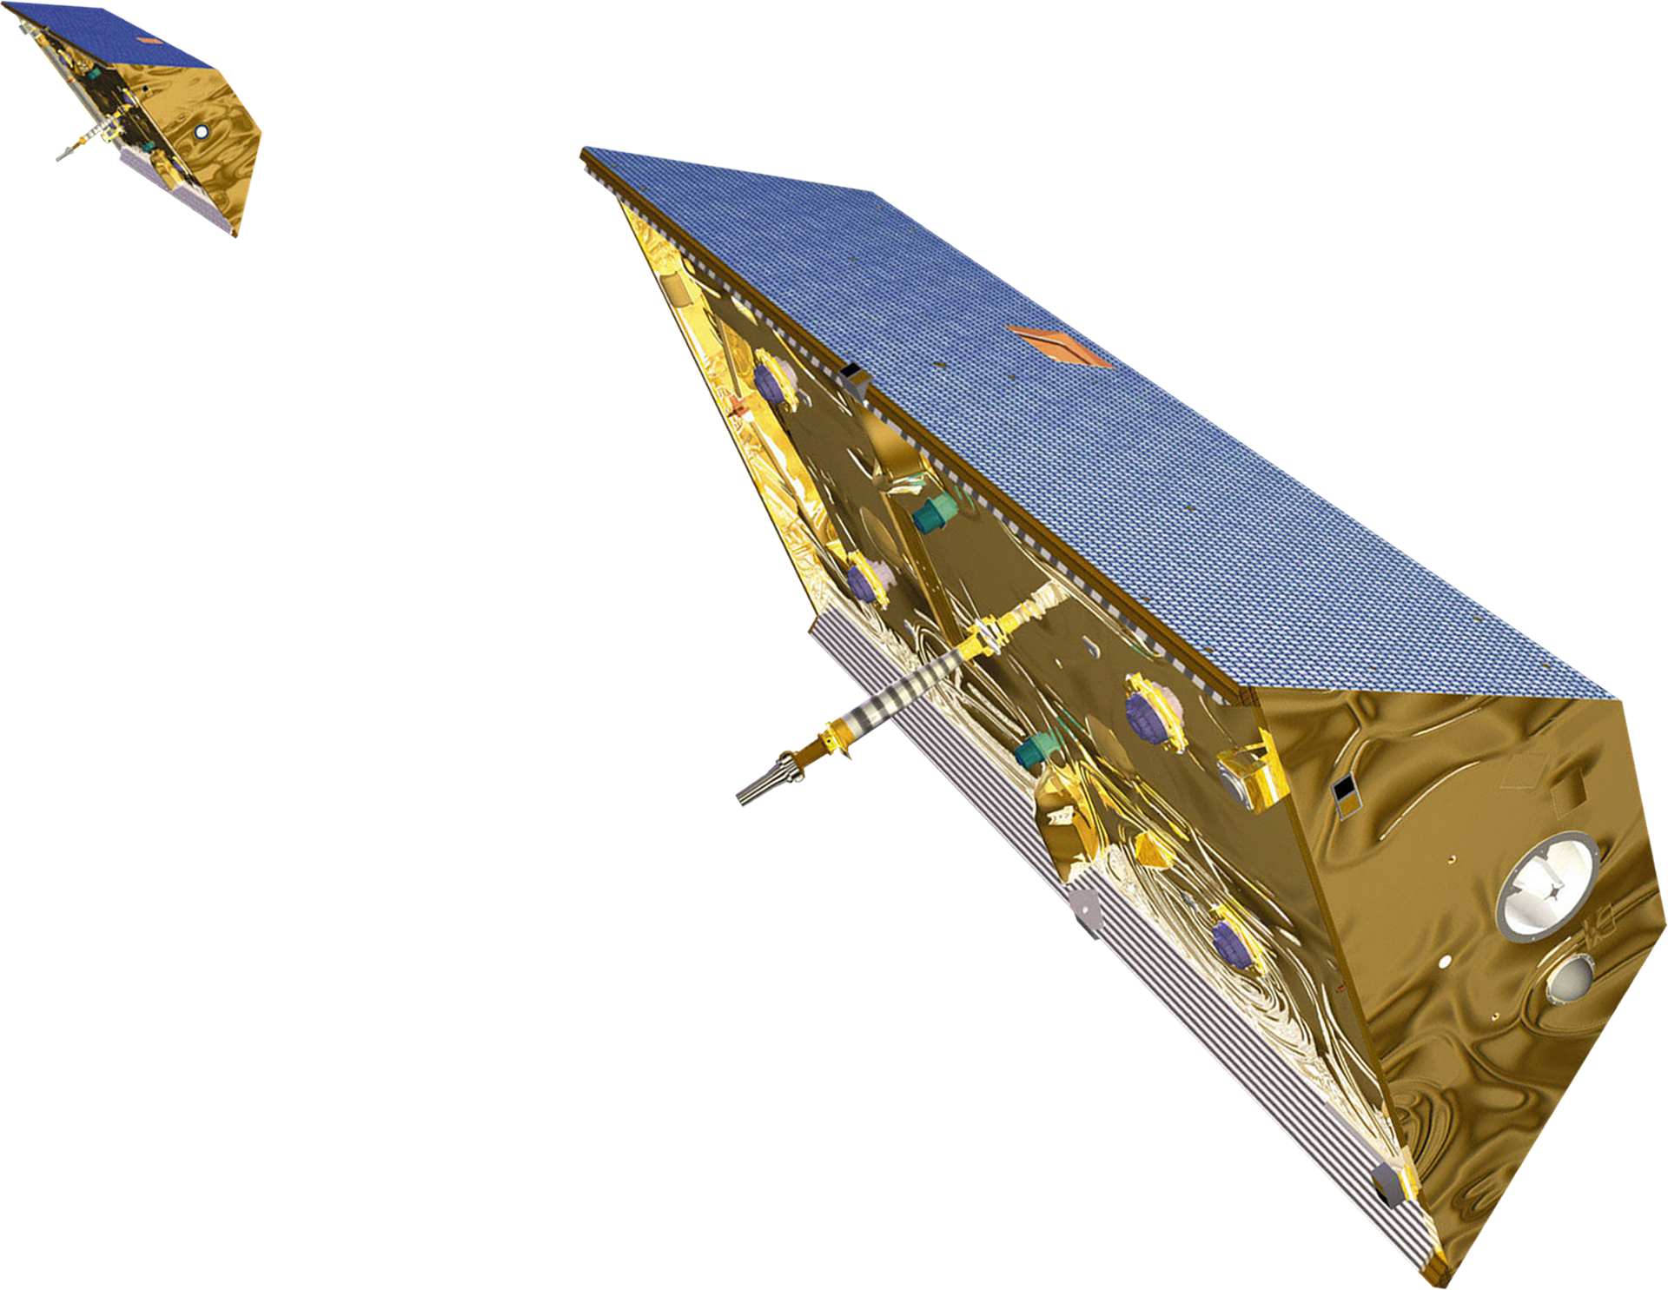
GRACE and GRACE Follow-on
Satellite tracking

Slide 22
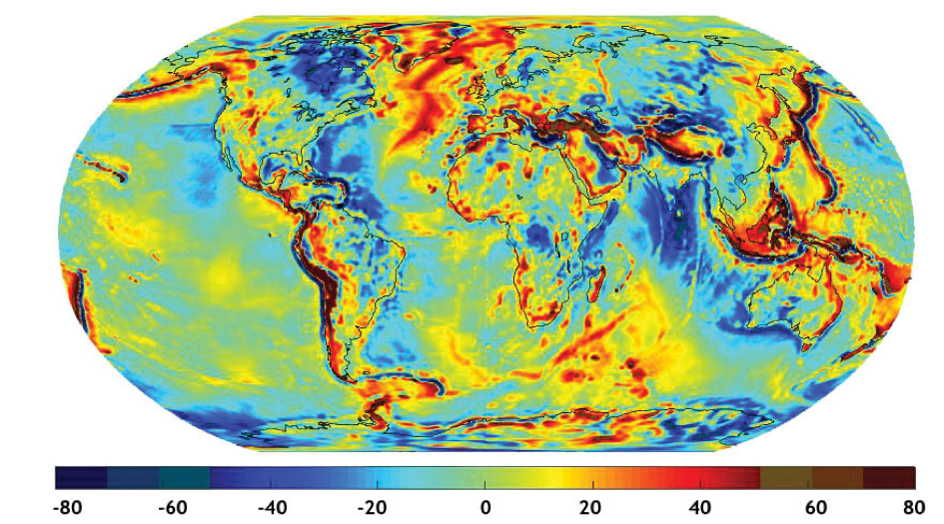
GRACE and GRACE Follow-on
Satellite tracking

Slide 23
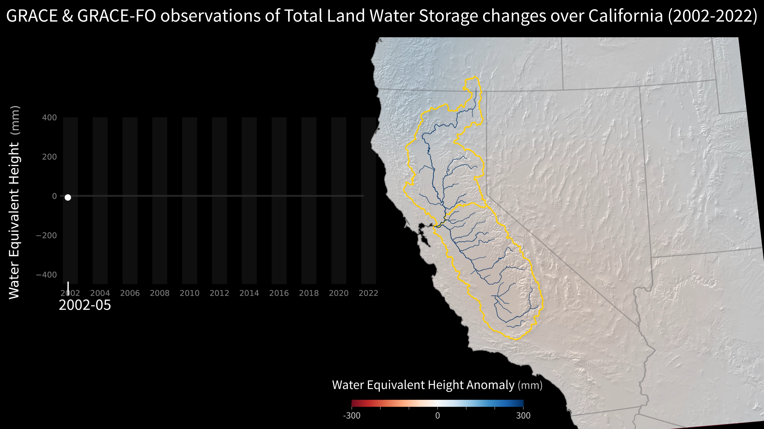
How to measure the geoid?
Satellite tracking

Slide 24
Gravity Surveying

Slide 25
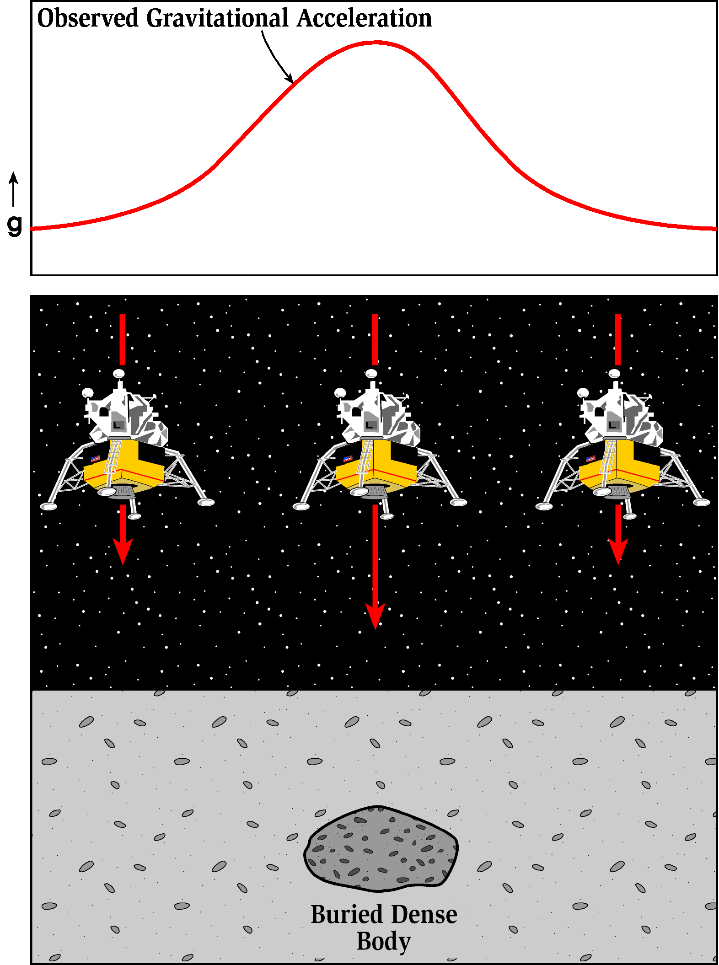
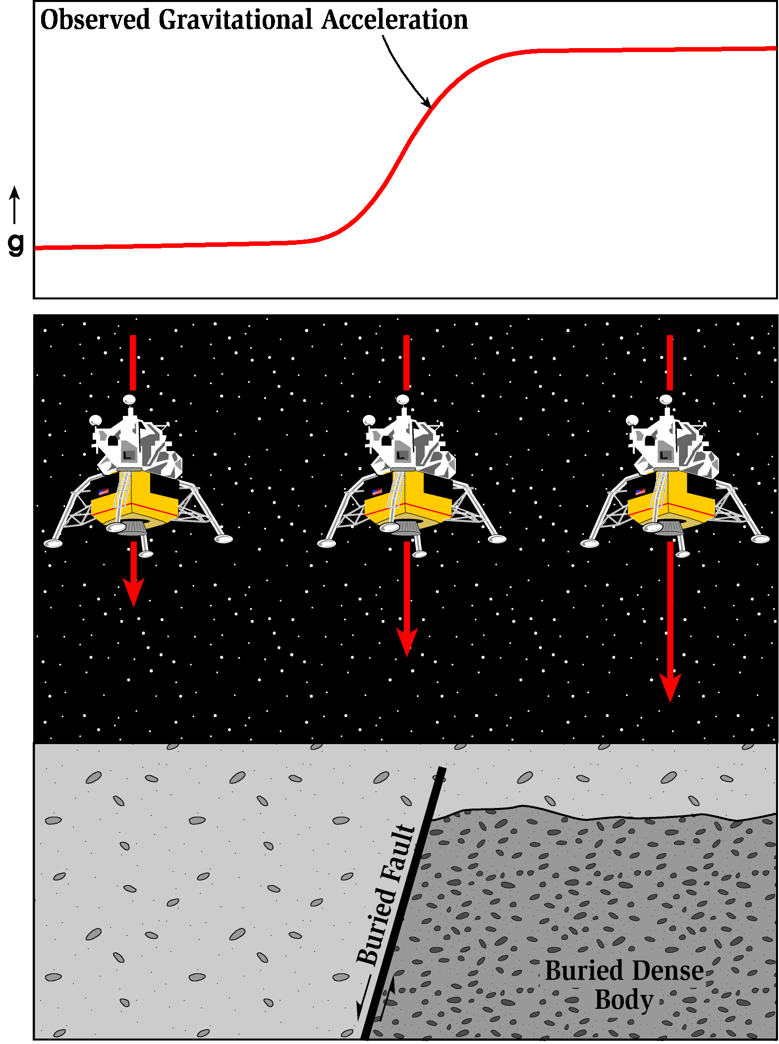
Gravity surveying – related to subsurface density variations
Most gravity surveys are conducted over small areas and consequently measure small variations in gravity, “microgravity”
Data can be easily interpreted “by eye,” but real analysis is more complex

Slide 26
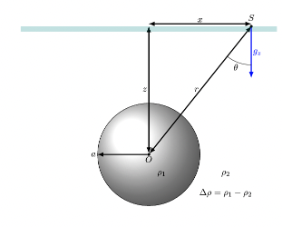
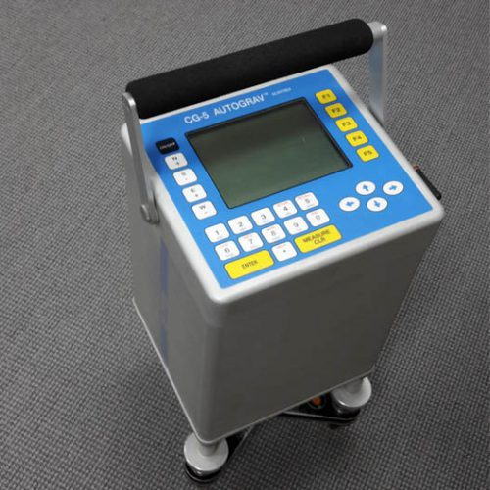
Gravity anomaly due to a spherical mass
Image courtesy Chuck Connor

Slide 27
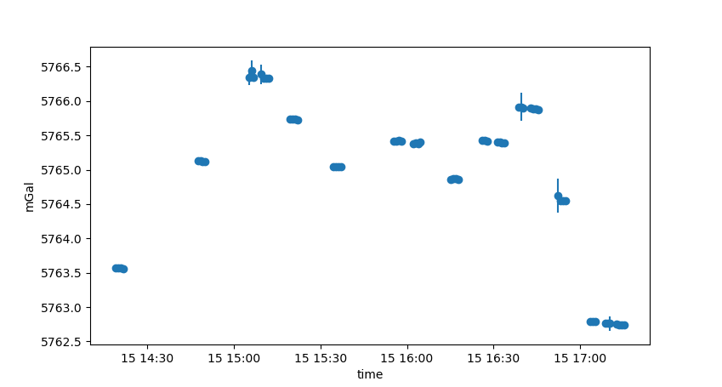
Without corrections, will see lots of gravity varations

Slide 28
Without corrections, will see lots of gravity varations
Stations:
McNutt 319, Stonehenge, front of Bishop tunnel, under McNutt Commons, top of little hill, Puck, then back
McNutt 319

Slide 29
Without corrections, will see lots of gravity varations
Drift is corrected by instrument, but some drift still remains, likely due to not calibrating long enough
McNutt 319

Slide 30
Gravity corrections
Instrumental drift and earth tides
Need repeated measurements at the same location

Slide 31
Gravity corrections
Instrumental drift and earth tides
Need repeated measurements at the same location
Latitude correction (mgal)

Slide 32
Gravity corrections
Instrumental drift and earth tides
Need repeated measurements at the same location
Latitude correction (mgal)
Free-air correction (mgal)
A function of height above MSL:

Slide 33
Gravity corrections
Instrumental drift and earth tides
Need repeated measurements at the same location
Latitude correction (mgal)
Free-air correction (mgal)
A function of height above MSL:
Bouguer slab correction

Slide 34
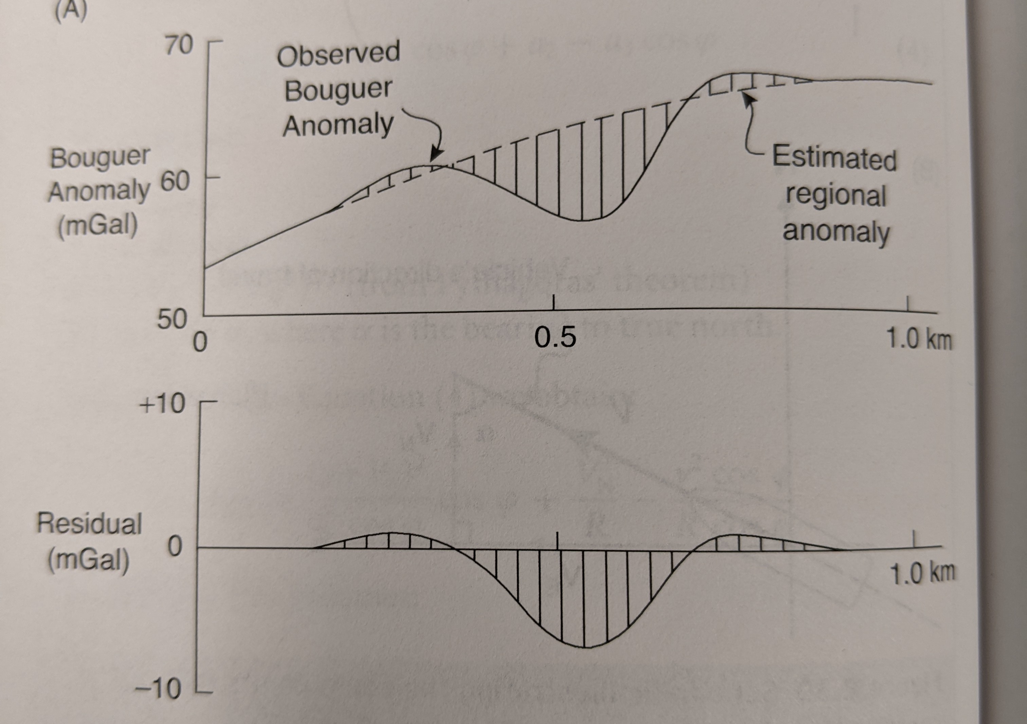
Gravity corrections
The Bouguer correction *should* correspond only to lateral density changes in the near-surface or upper crustal environment (depending on the scale of the survey)
In reality, there are several other corrections that may need to be applied
Terraine correction
Eotvos correction (for airborne, marine acquisitions)
Buildings, basements, etc.
Regional correction
Reynolds textbook

Slide 35
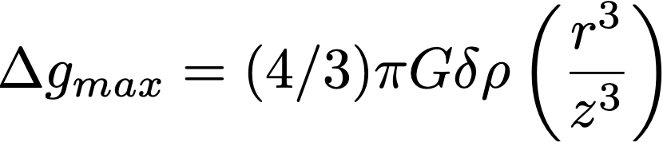
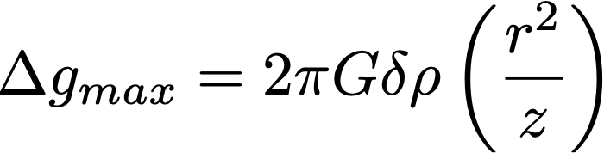
Maximum gravity anomalies due to various geometric shapes
Sphere:
Horizontal cylinder:
Buried infinite slab:
Reynolds, An introduction to Applied and Environmental Geophysics

Slide 36
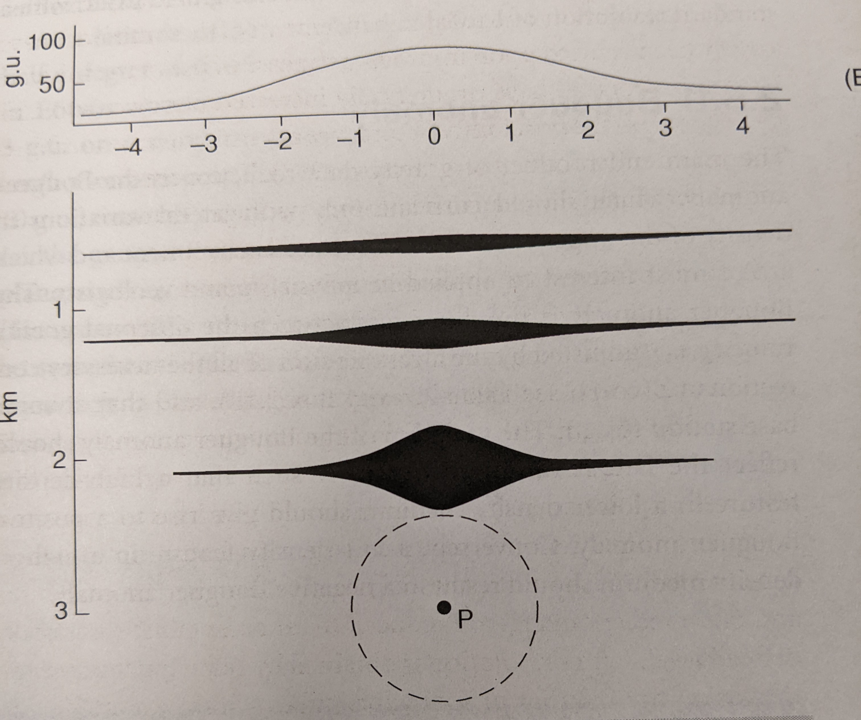
Going from gravity to density is not easy
Multiple density models produce identical gravity surface profiles
“non-uniqueness”
How can we distinguish between these?
Reynolds textbook

Slide 37
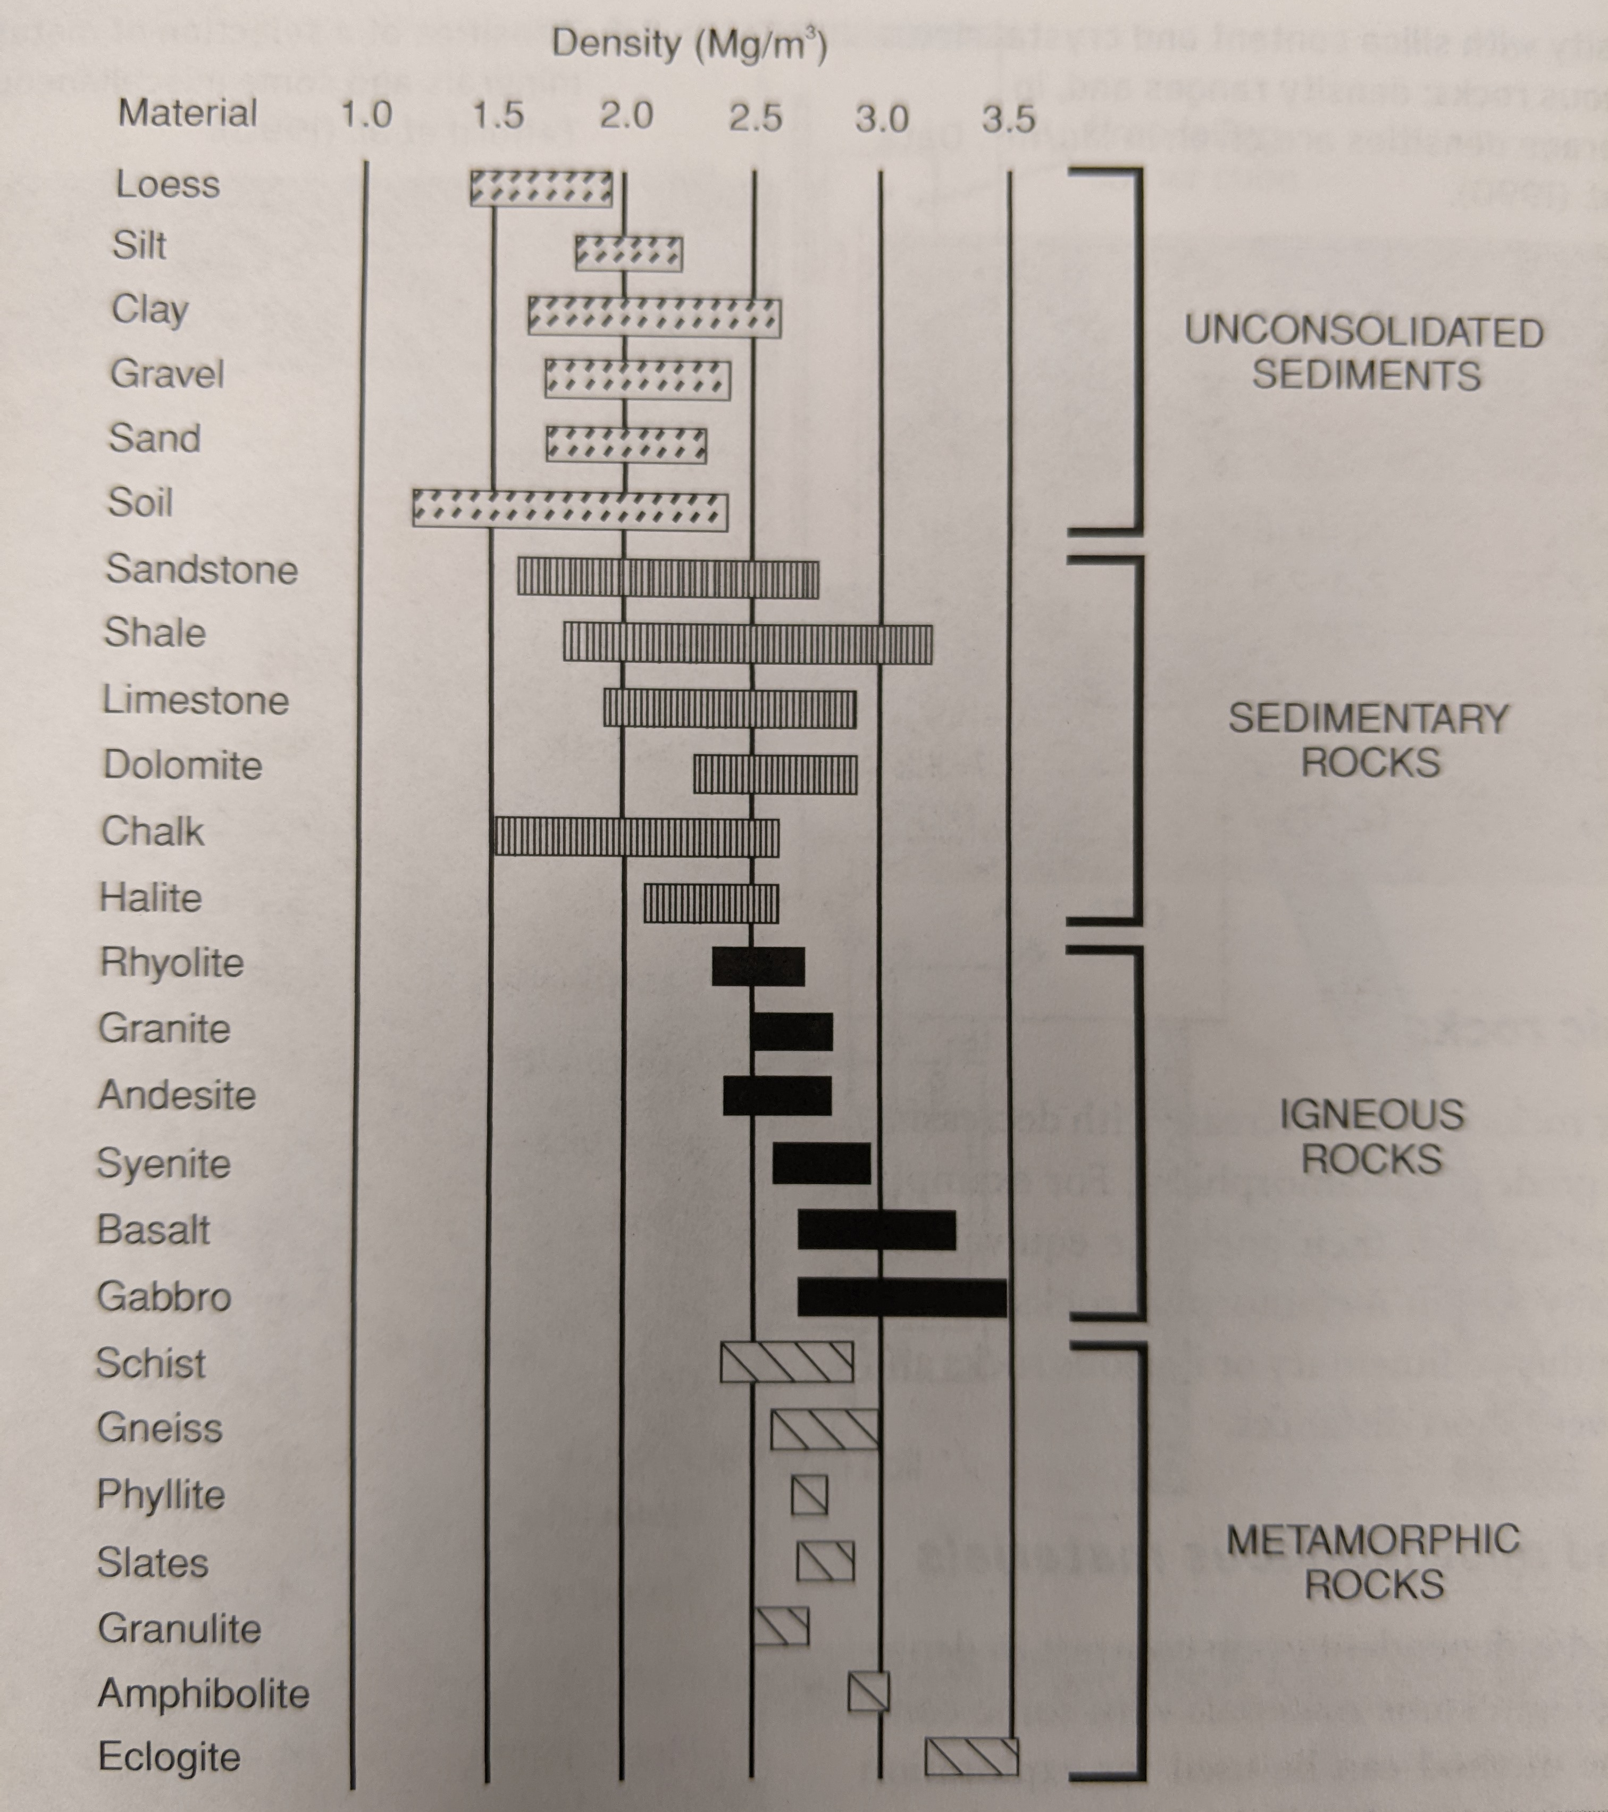
Some common rock densities
These can be correlated with other rock properties, such as seismic wavespeed, electrical resistivity, and magnetic properties to better constrain geologic models

Slide 38
Gravity Modeling

Slide 39
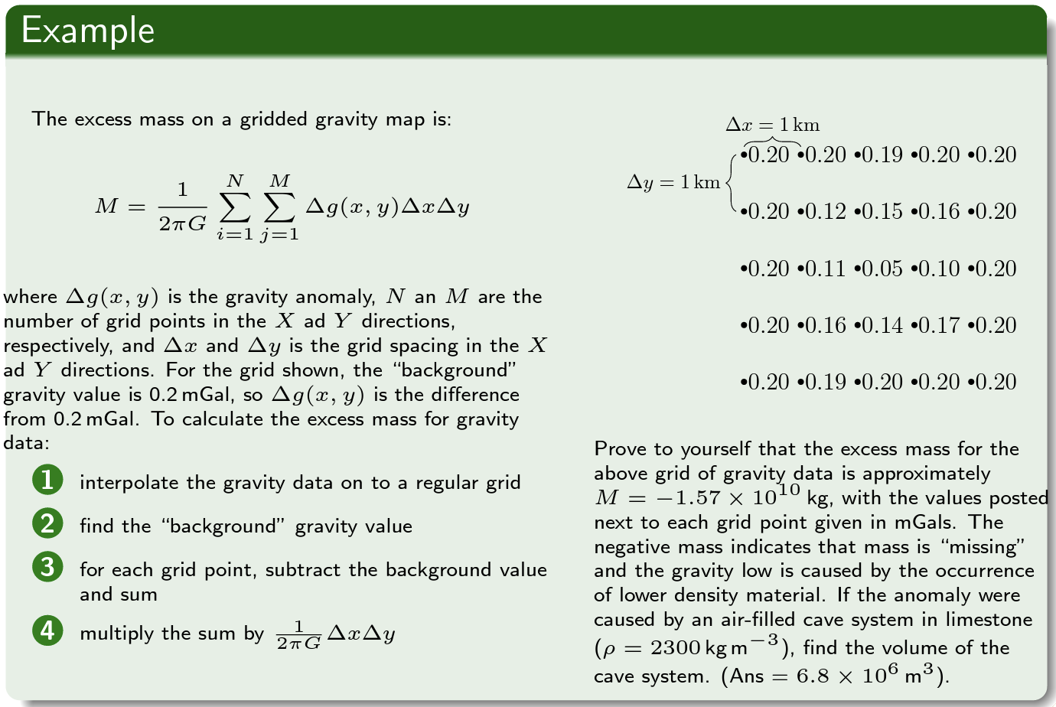
Going from gravity to density is not easy
Example from Chuck Connor, USF

Slide 40
Simple to set up Challenging to perfect
Basic approach:
Discretize domain into small sub-regions (e.g. a grid)
Assumption is anomalies are due to variations in the background density
Can adjust density variations and solve for predicted gravity signal (forward problem)
Can try to solve for density variations that produced a given dataset (inverse problem)
0 | 0 | 0 | 0
0 | 1 | 1 | 0
0 | 0 | 0 | 0
Cartoon illustrating density and gravity anomalies

Slide 41
References
Barzaghi R, Carrion D, Pepe M, Prezioso G. Computing the Deflection of the Vertical for Improving Aerial Surveys: A Comparison between EGM2008 and ITALGEO05 Estimates. Sensors (Basel). 2016 Jul 26;16(8):1168. doi: 10.3390/s16081168. PMID: 27472333; PMCID: PMC5017334.

